Slide 1

Using Cloud Infrastructure as Code (IaC)
to Deploy a Web Application
Cloud Computing · CSE456
Supervised by Dr. Wagdy Anis
Name | ID
Ahmed Mohamed Elsayed Tabbash | 20P1076
Yaman Abdelhamid Elewa | 2002078
Ahmed Abdallah Nofull | 22P0255
Ferass Ahmed Mostafa | 23P0304

Slide 2
The Problem
Why build infrastructure by hand at all?
— Clicking through a web console to build a network is slow and hard to repeat.
— Nobody can review what was clicked — there is no record, only the result.
— Rebuilding the same environment twice gives you two slightly different environments.
— A mistake made by hand gets fixed by hand — over and over, inconsistently.
Infrastructure as Code: describe the infrastructure in a file let the cloud build it.

Slide 3
Project Goal
Deploy a web application on AWS using IaC only
— One CloudFormation template + one JSON parameter file.
— Zero manual configuration of individual resources.
— A network across two Availability Zones, web servers hidden in private subnets.
— A load balancer as the single public entry point.
— Prove it survives a server failure — and can be destroyed cleanly.

Slide 4
Architecture
Two Availability Zones · public tier in front, private tier behind
Application Load Balancer
one fixed public DNS name
Availability Zone A
Availability Zone B
Public subnet
NAT Gateway
Public subnet
NAT Gateway
Private subnet
EC2 web server
Private subnet
EC2 web server
Auto-Scaling Group keeps 2 servers running (max 3) — one in each zone.

Slide 5
The Code
32 resources, defined declaratively
— infrastructure.yaml — the template
· VPC, 4 subnets, Internet Gateway
· 2 NAT Gateways + Elastic IPs
· 3 route tables, security groups
· Load Balancer, Target Group, Listener
· Launch Template + Auto-Scaling Group
— params.json — the configuration
· CIDR ranges, environment name
· instance type, AMI (auto-resolved)
ServersAutoScalingGroup:
Type: AWS::AutoScaling::AutoScalingGroup
DependsOn: [PrivRoute1, PrivRoute2]
Properties:
MinSize: '2'
MaxSize: '3'
VPCZoneIdentifier:
- !Ref PrivateSubnet1
- !Ref PrivateSubnet2
TargetGroupARNs:
- !Ref LBTargetGroup

Slide 6
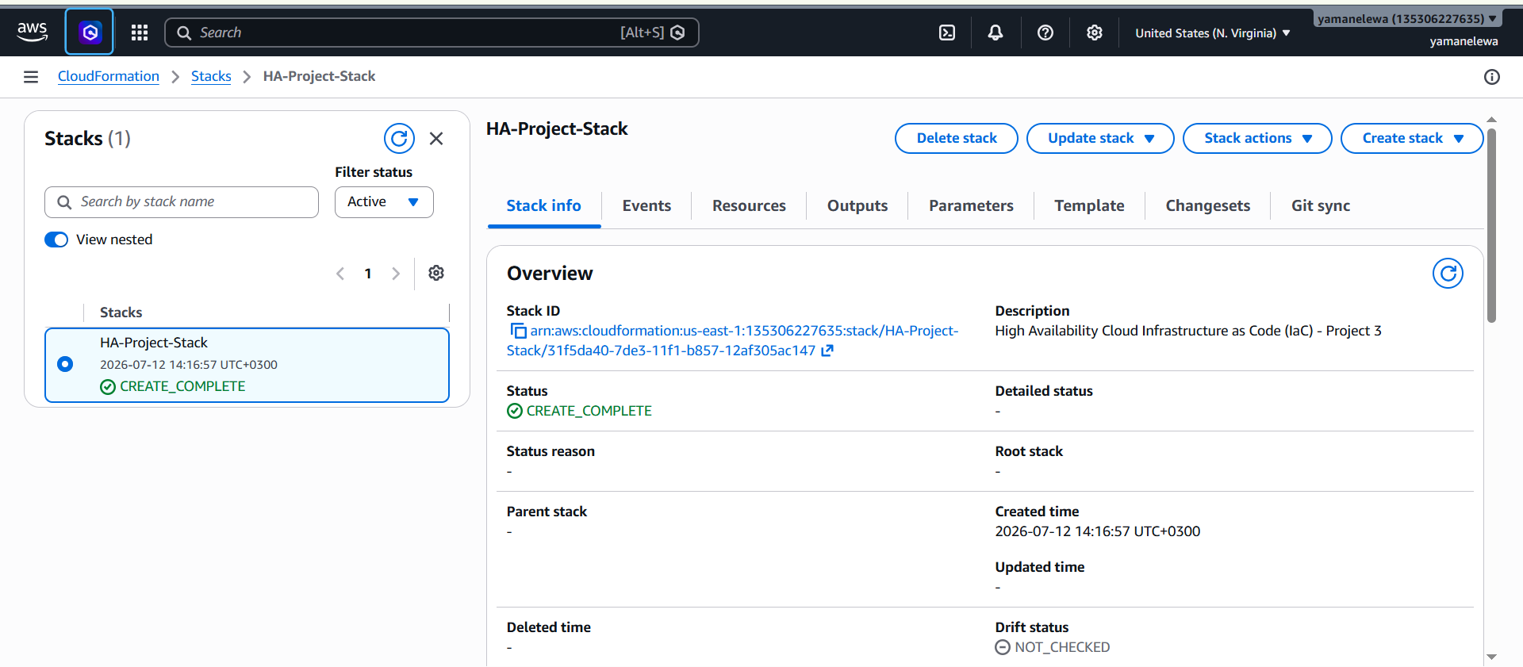
Deployment
CREATE_COMPLETE — all 32 resources built in dependency order

Slide 7
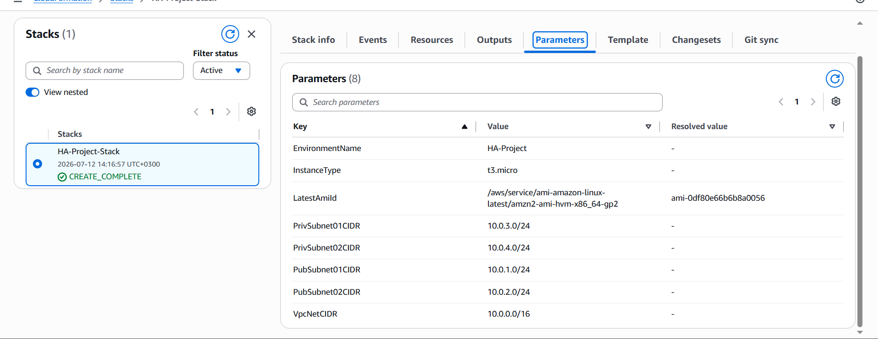
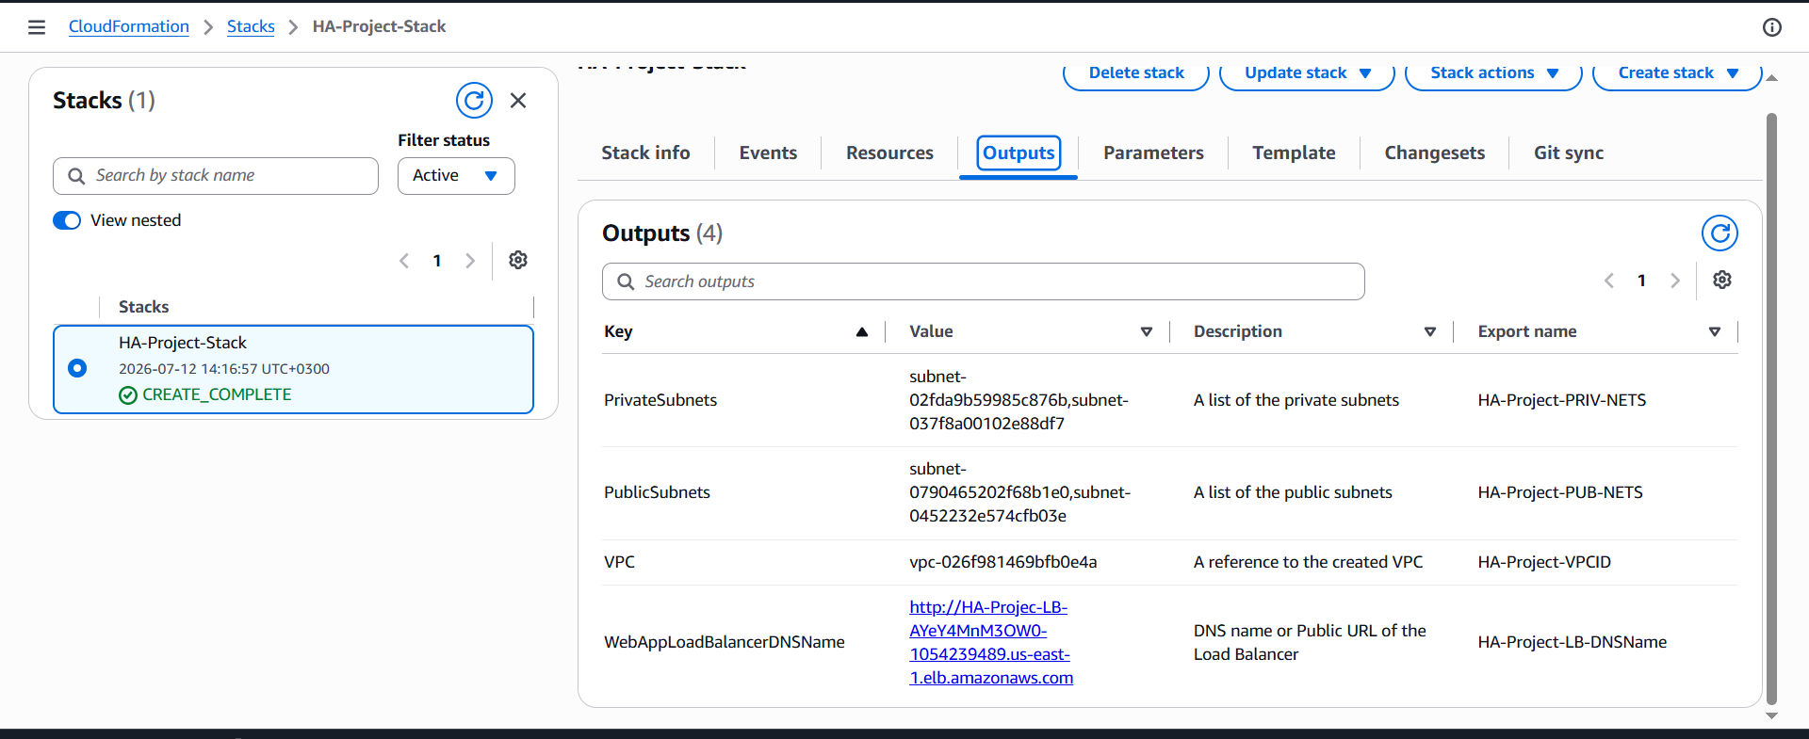
Parameters & Outputs
Configuration in — load balancer URL out
The 8 input parameters
The 4 exported outputs
The machine image is resolved automatically at deploy time —
the template is not tied to any region.

Slide 8
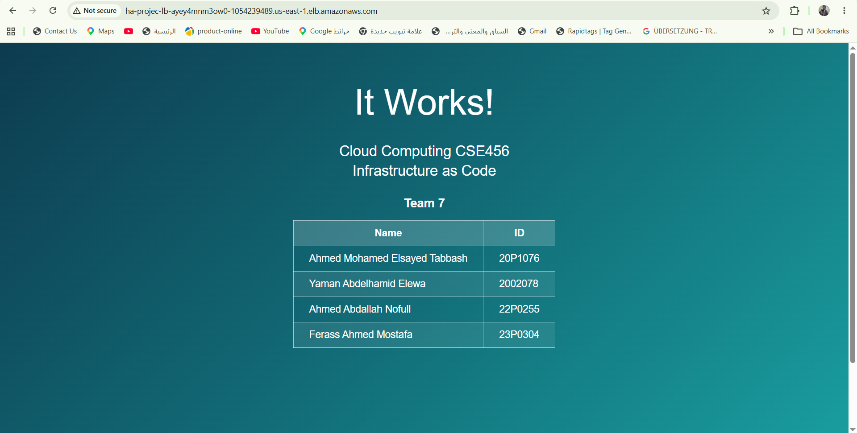
It Works
Served by EC2 instances in the private subnets, through the Load Balancer

Slide 9
The Real Test
What happens if we destroy a running server?
We terminated one on purpose.

Slide 10
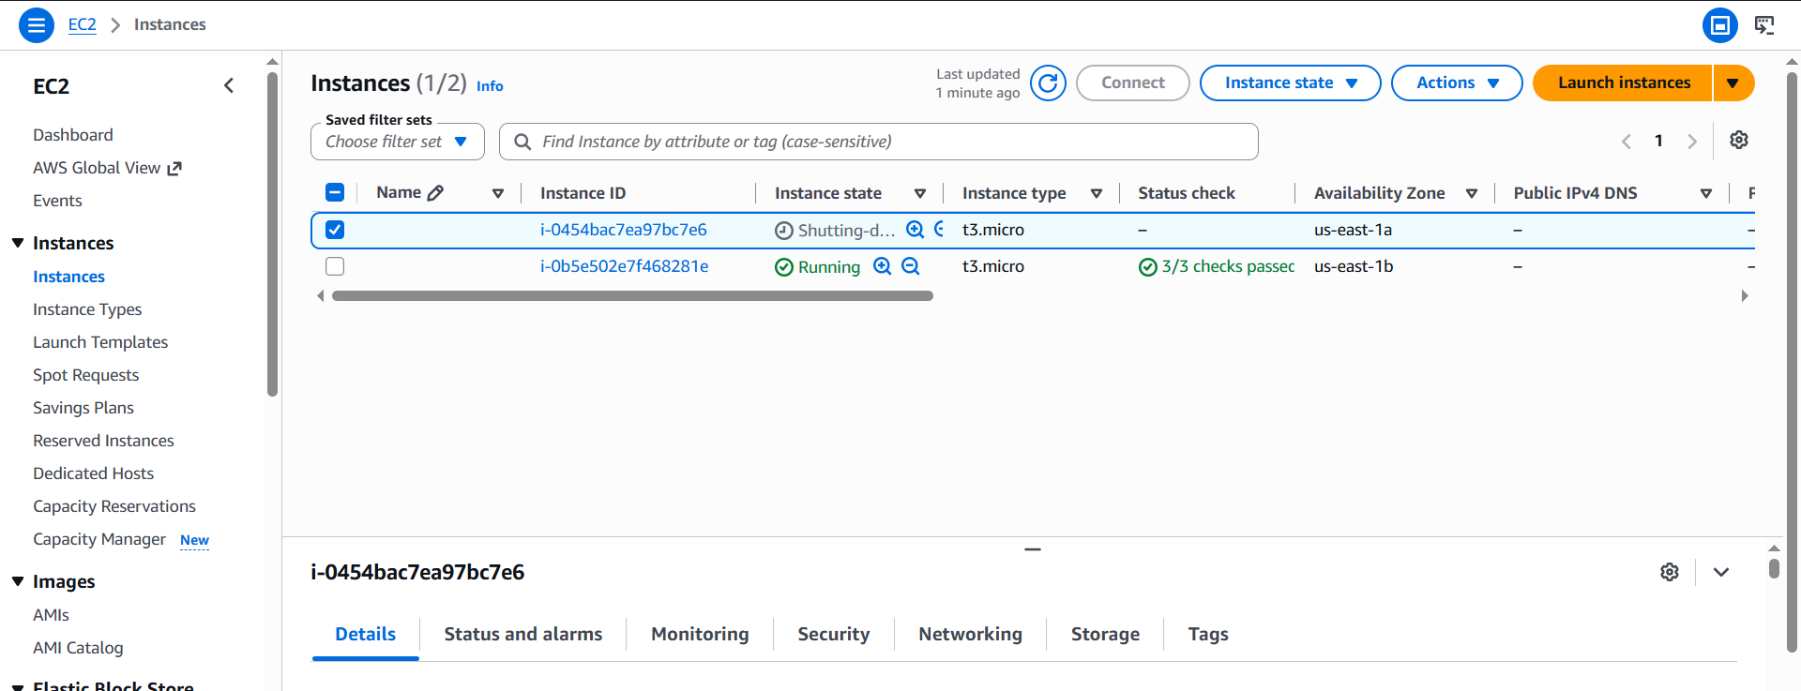
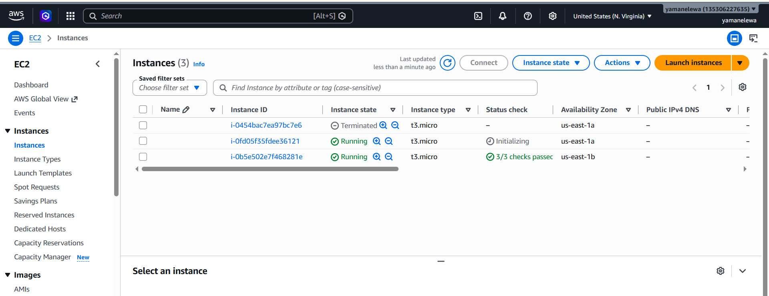
Recovery Test
Terminate one instance → Auto-Scaling replaces it automatically
1. Instance terminated
2. Replacement launched automatically
The Load Balancer DNS never changed.
The site stayed reachable at the same URL while its server was destroyed and rebuilt.

Slide 11
A Bug We Found
And why IaC made it a one-line fix
— The servers came up unhealthy — the load balancer returned 502.
— The boot log showed yum could not reach the package repositories. Apache was never installed.
— Cause: instances were launched before the NAT Gateway routes existed, so the private servers had no path to the internet at boot.
DependsOn: [PrivRoute1, PrivRoute2]
Fixed once, in code — the fix now applies to every future deployment, automatically.

Slide 12
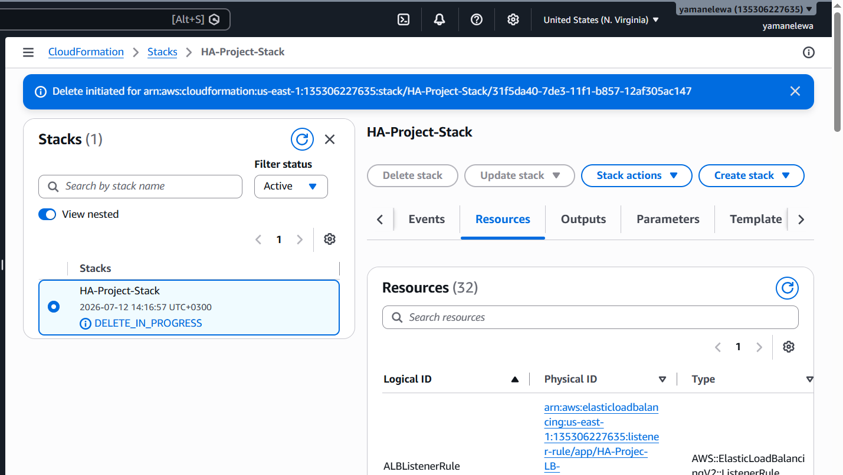
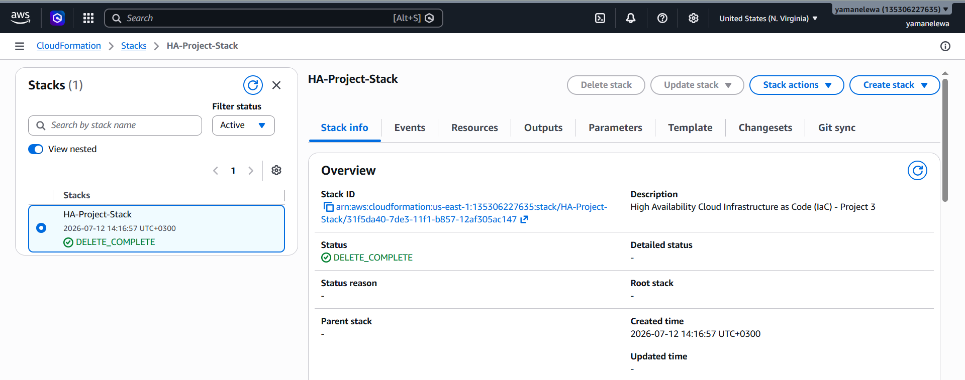
Teardown
One operation removes everything — no orphaned resources, no cost
DELETE_IN_PROGRESS
DELETE_COMPLETE

Slide 13
Conclusion
What Infrastructure as Code actually bought us
— A complete web application environment, deployed with zero manual configuration.
— Rebuildable identically, in any region, in about 15 minutes.
— It absorbed the loss of a server — no human intervention, no change of address.
— A defect was fixed once, in code — not repeatedly, by hand.
Infrastructure as Code enables the infrastructure to be deployed, rebuilt, and managed consistently.

Slide 14
Thank You
Questions?
Team 7 · CSE456 Cloud Computing

